Slide 1



UNIT 3
LESSON 12
Looking forward to the future
Part 4

Slide 2
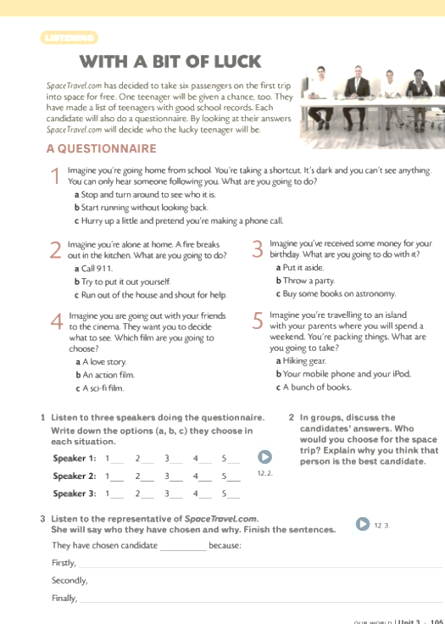

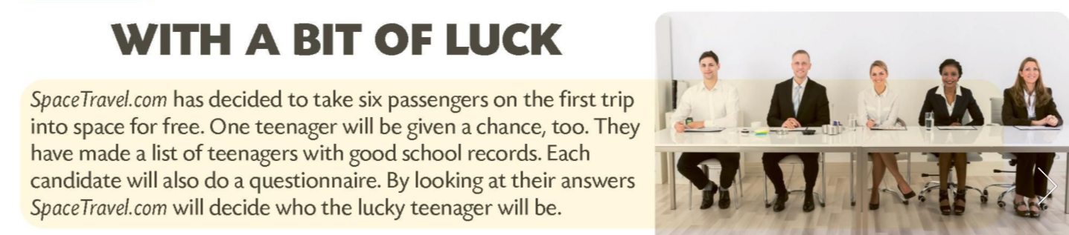
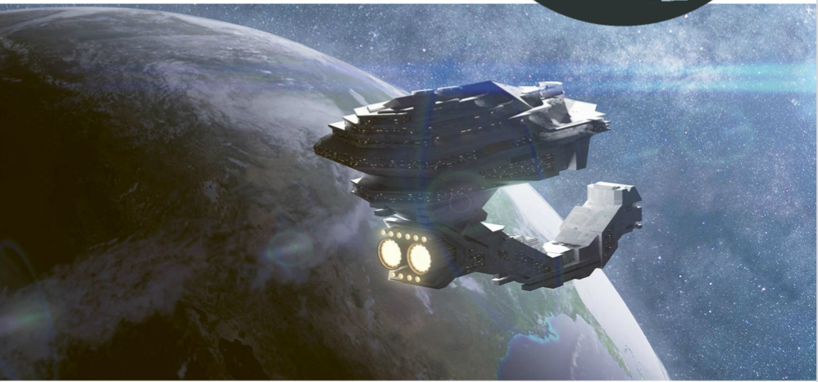
Present your interview with an alien or your idea of the future.

Slide 3
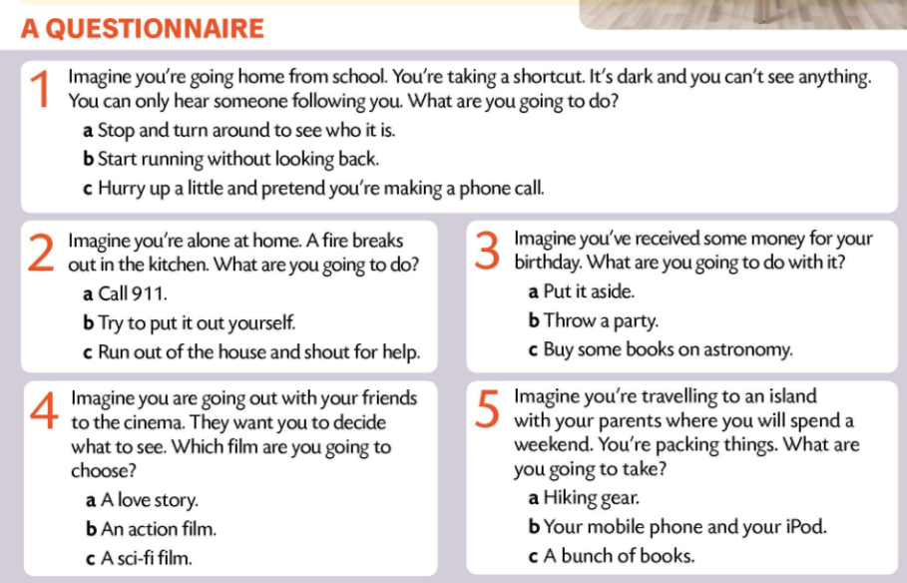
SpaceTravel.com has decided to...
One teenager will...
They have made a...
Each candidate will also...
By looking at their answers...

Slide 4
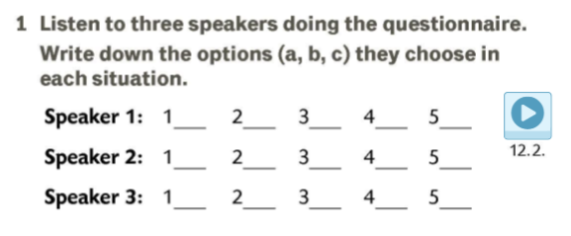

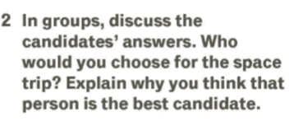
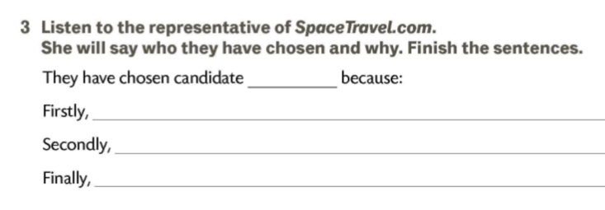
b
a
a
b
c
a
b
c
c
a
c
c
b
a
b
2
she’s interested in science.
she’s curious, brave and determined.
she would like to travel to space.

Slide 5
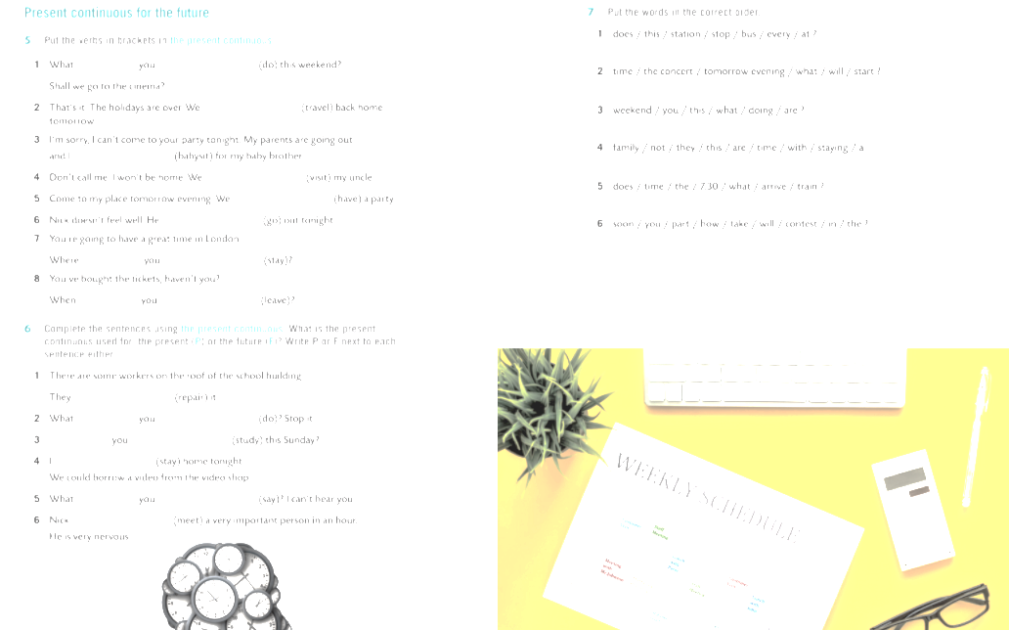
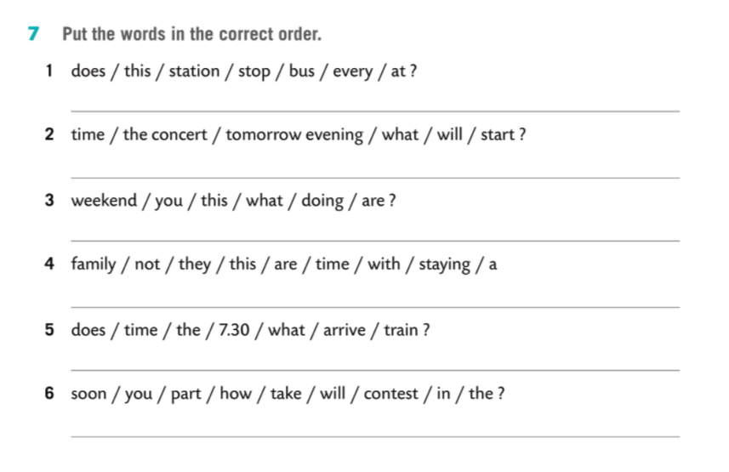
Does this bus stop at every station?
What time will the concert start tomorrow evening?
What are you doing this weekend?
They are not staying with a family this time.
What time does the 7.30 train arrive?
How soon will you take part in the contest?

Slide 6
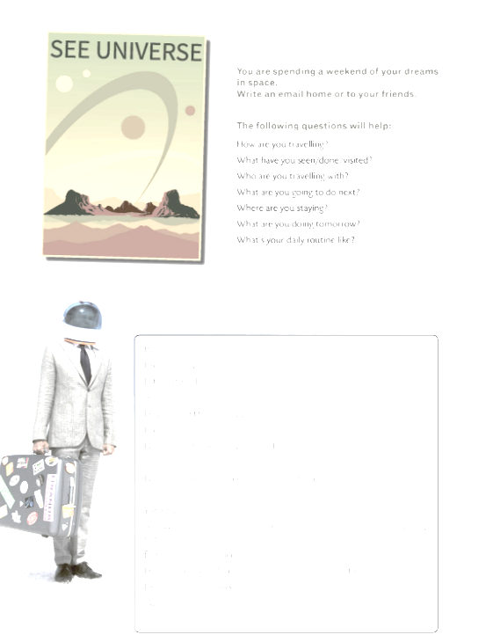
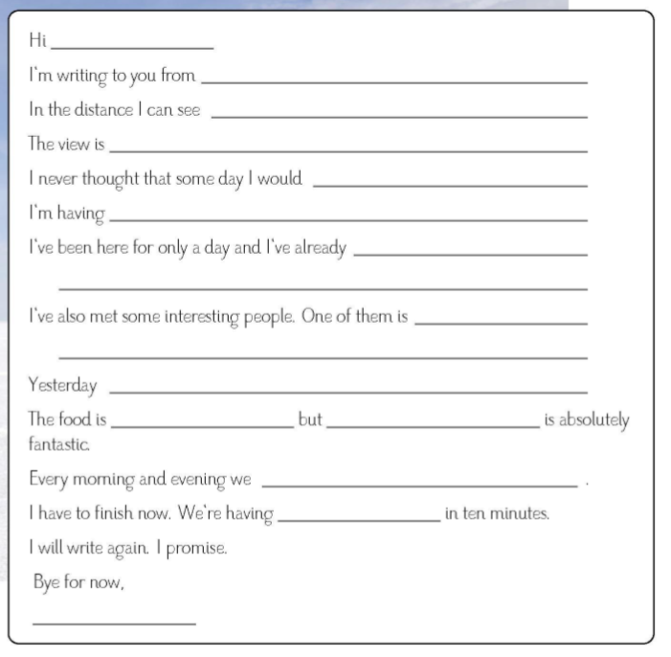
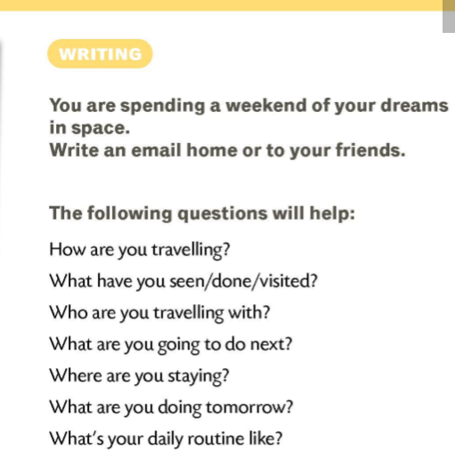

Slide 7

